Slide 1
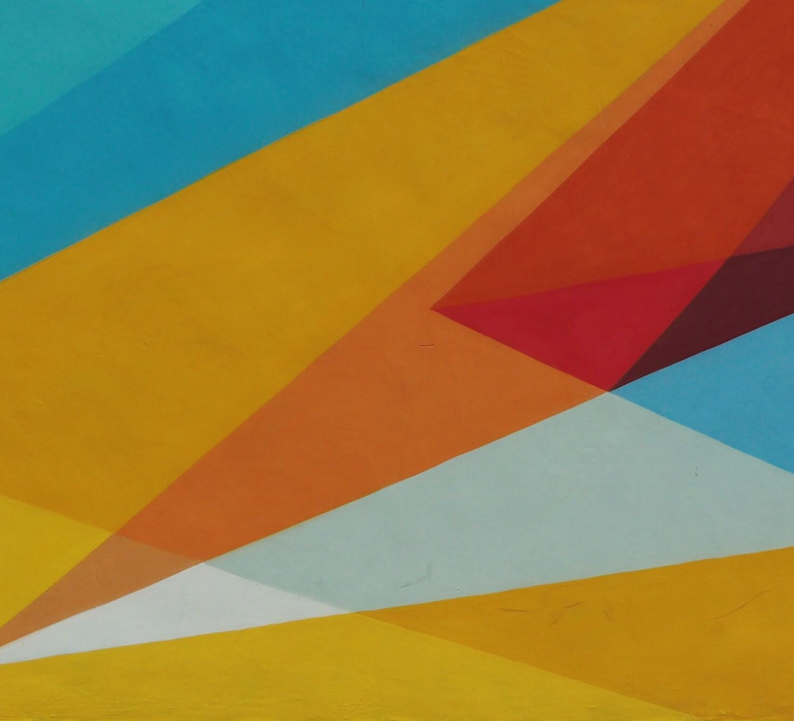
Adventures with triangles in BILLIARDS
Dan S. Reznik
RONALDO GARCIA
JAIR KOILLER
IMPA, Rio de Janeiro, July 29th, 2019

Slide 2

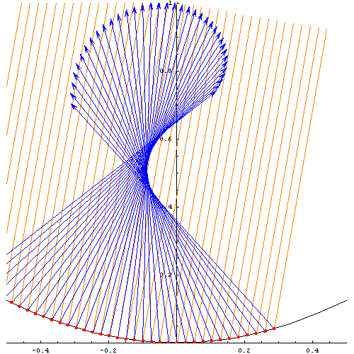
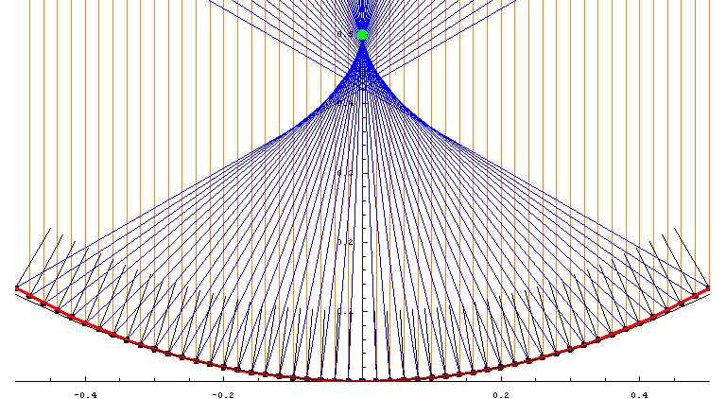
Ray tracing Curved mirRORS 2006

Slide 3
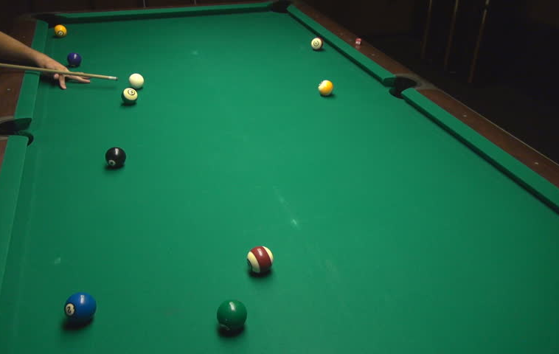
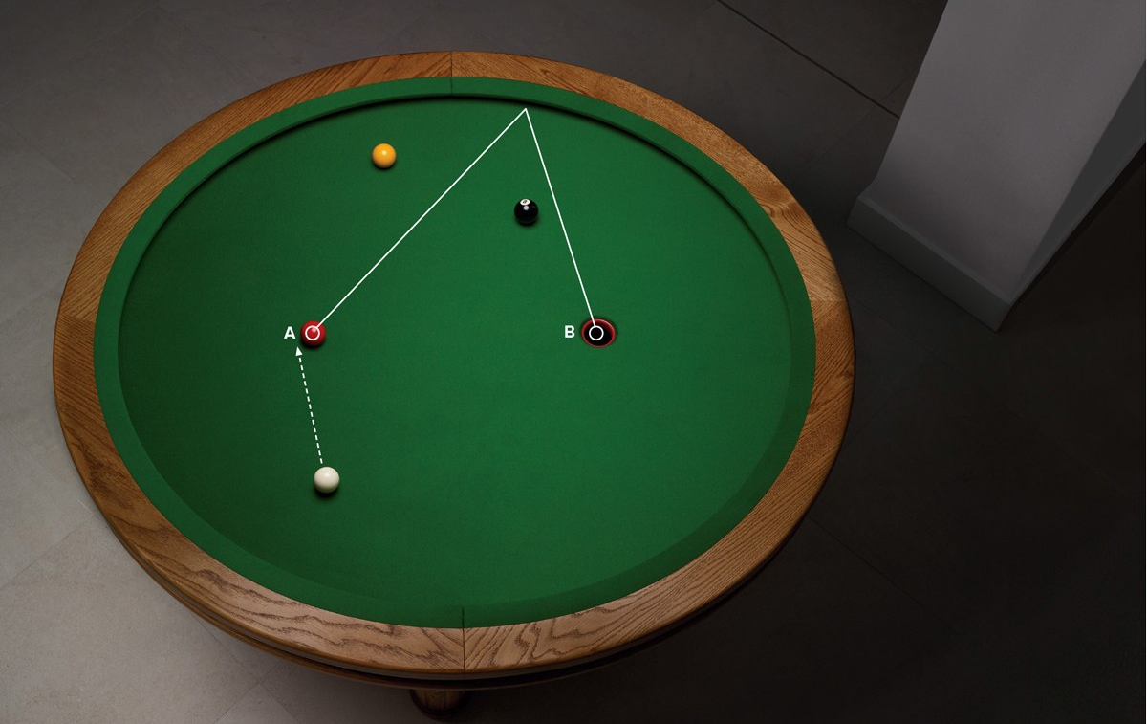
Pool table / jeu de billards

Slide 4
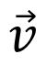
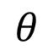
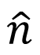
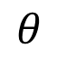
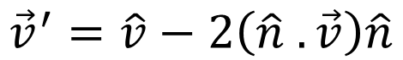
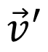
Conservation of linear momentum
$$θ$$
$$θ$$
$$\vec{v}$$
$$\hat{n}$$
$$\vec{v}′$$
$${\vec{v}}^{′}=\hat{v}−2\left(\hat{n} .\vec{v}\right)\hat{n}$$

Slide 5
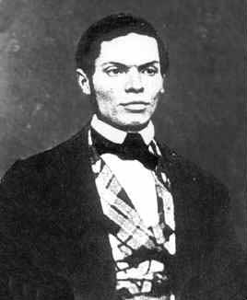
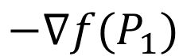
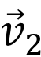
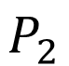
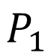
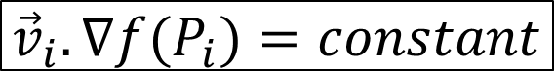
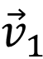
Conservation of momentum
$$P_{1}$$
$${\vec{v}}_{1}$$
$$−∇f(P_{1})$$
Ferdinand Joachimsthal
1818-1861
Confocal “Caustic”
$${\vec{v}}_{2}$$
$$P_{2}$$
$${\vec{v}}_{i}.∇f(P_{i})=constant$$

Slide 6
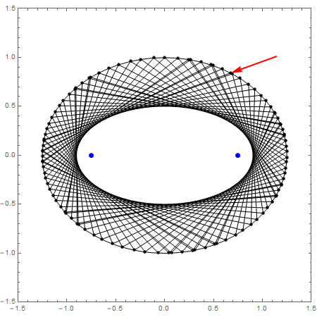
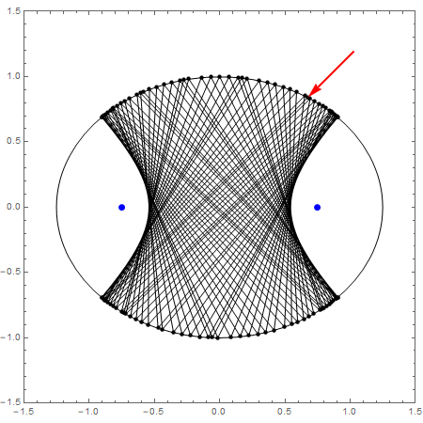
causticS VIDEO

Slide 7
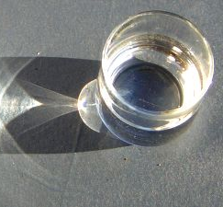
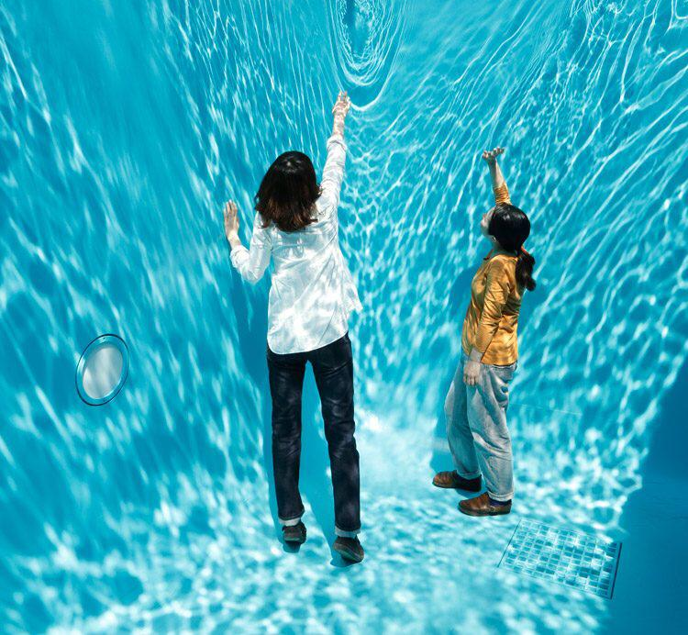

Slide 8
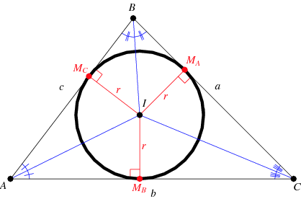
incenter

Slide 9
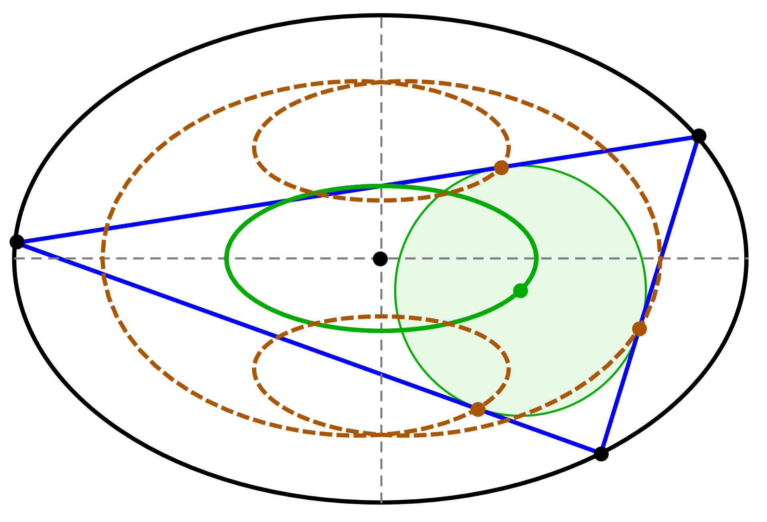
triangular ORBITS (2011) VIDEO 1 VIDEO 2

Slide 10
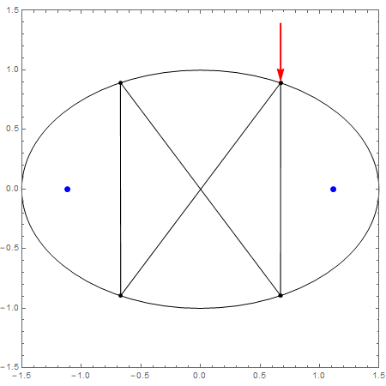
N=4 Self-intersecting VIDEO

Slide 11
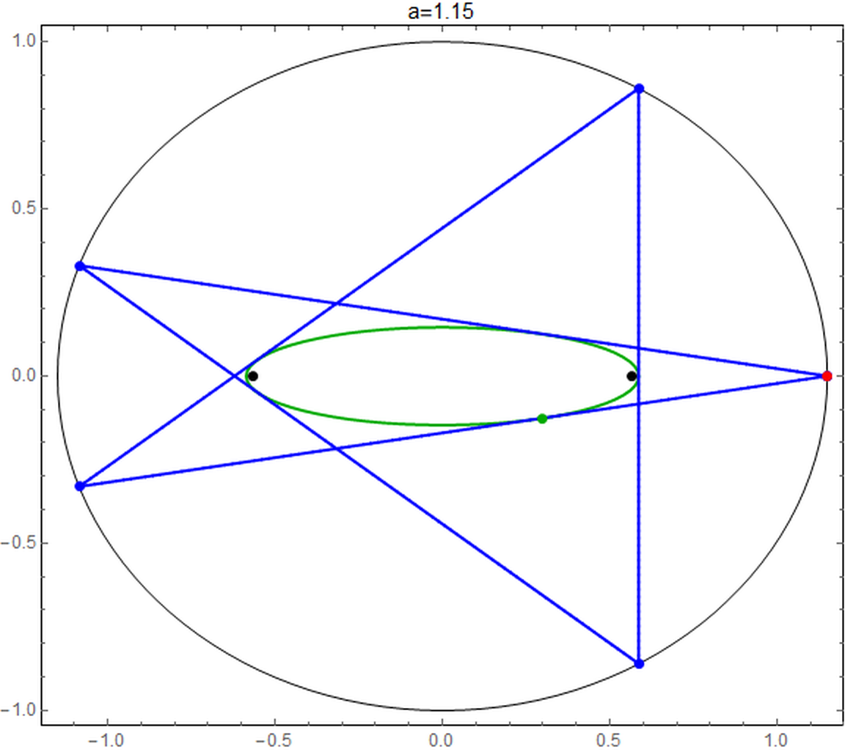
Self-intersecting pentagram video APPLET

Slide 12
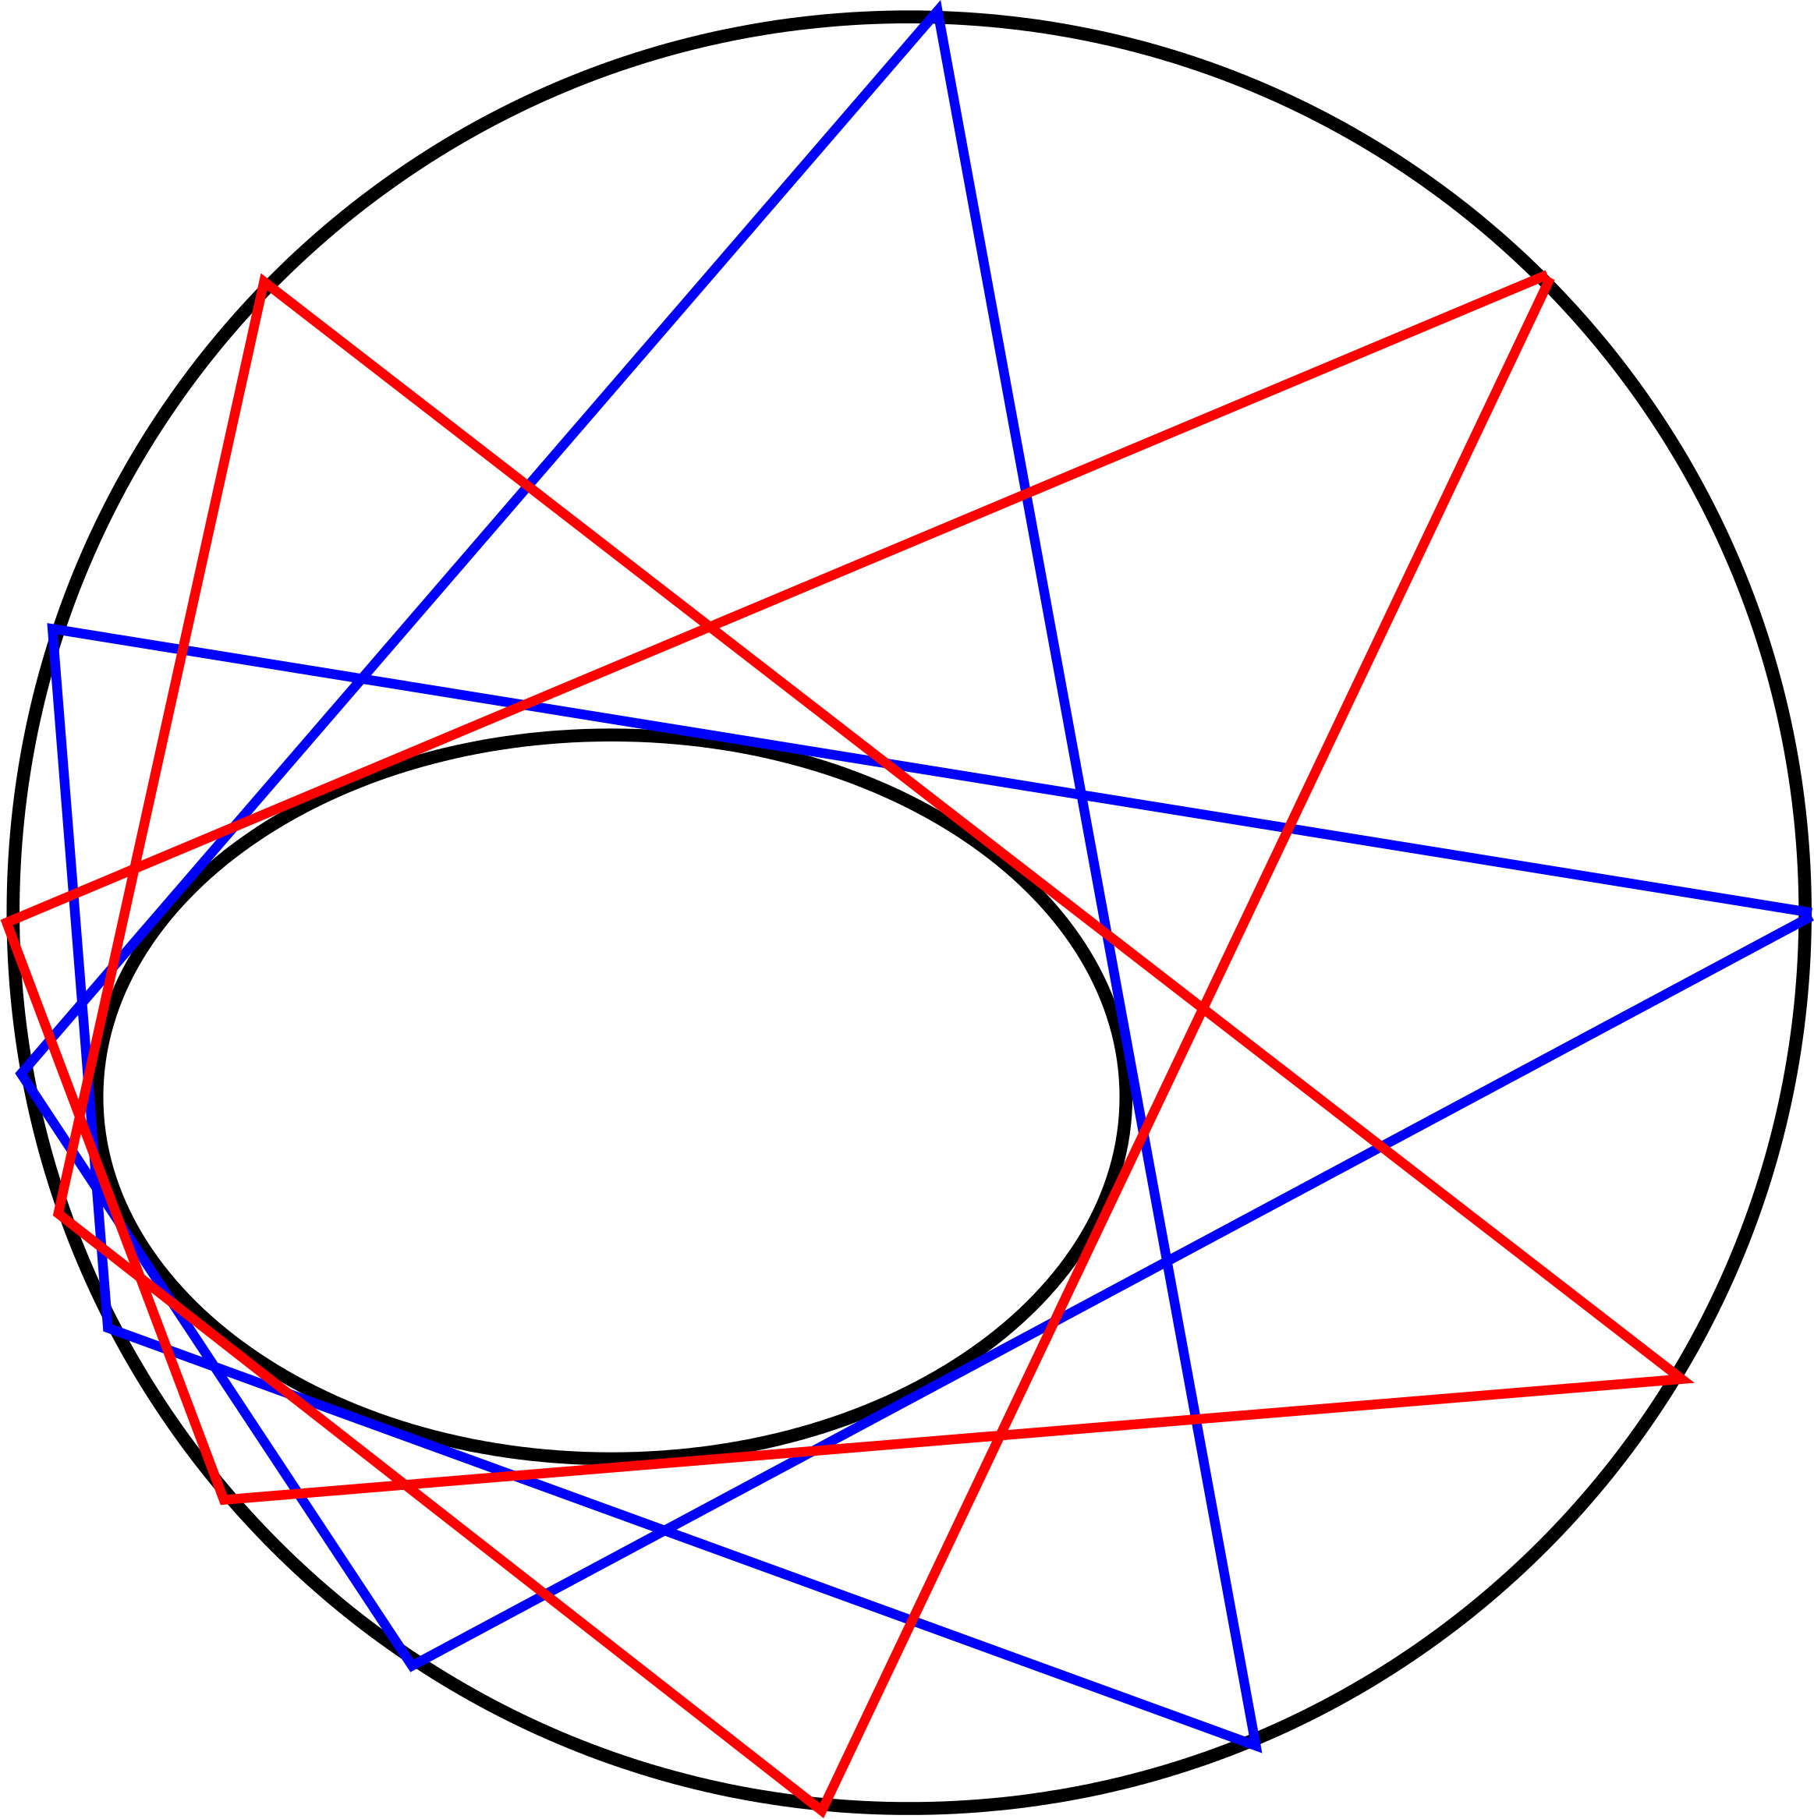
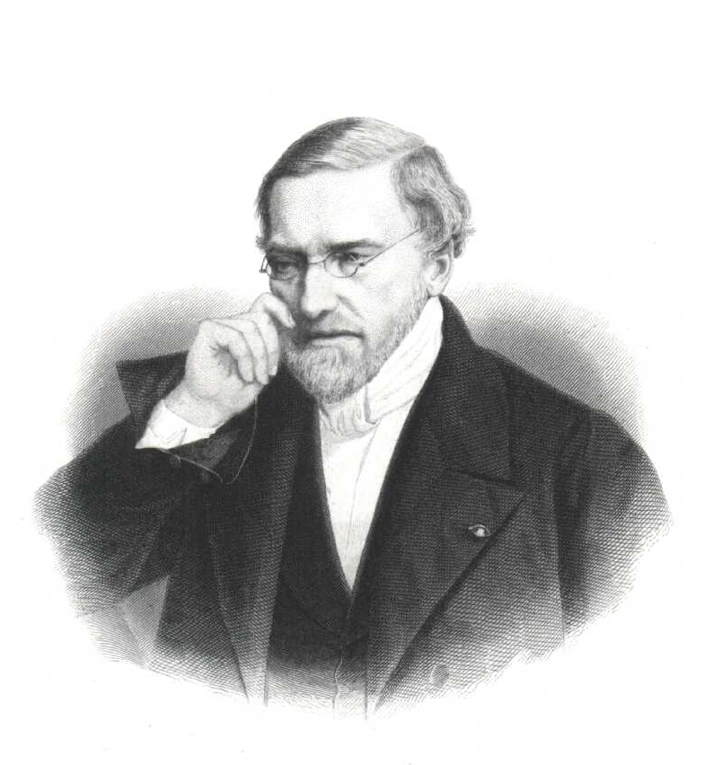
Poncelet “Porism”
Jean-Victor Poncelet
1788–1867

Slide 13
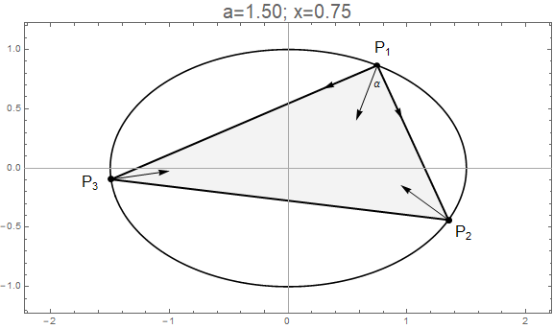
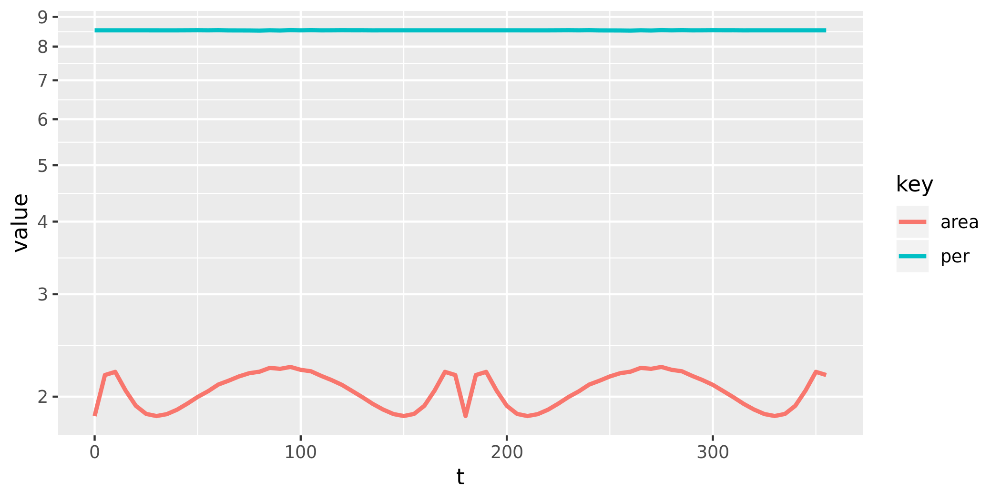
Perimeter is MAXIMAL & CONSTANT [integrable hamiltonian]

Slide 14
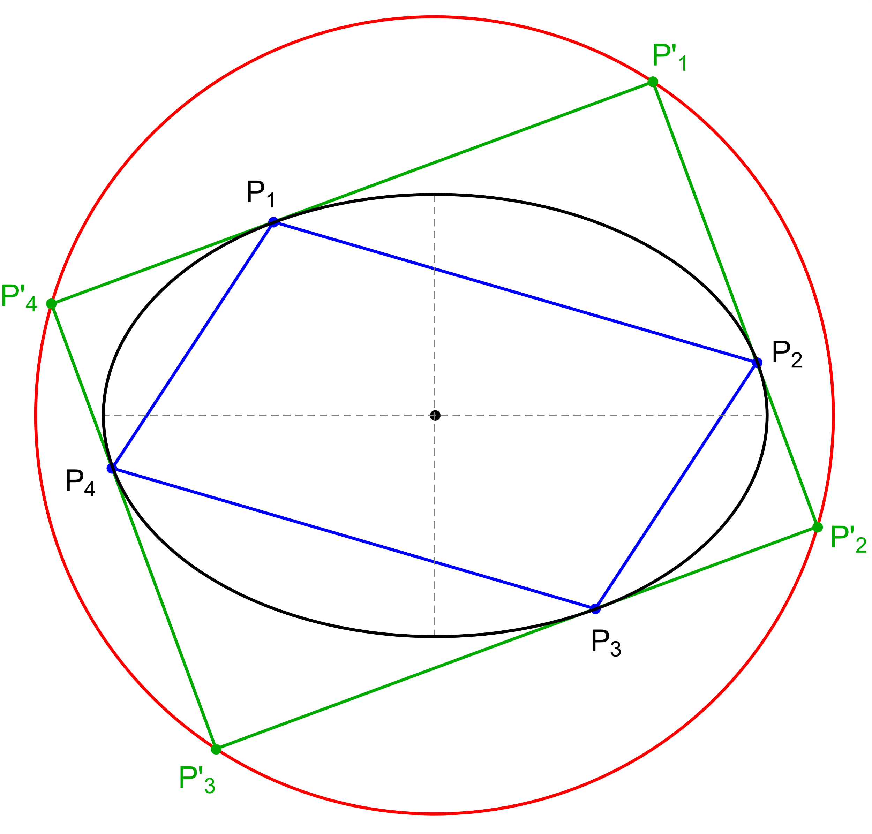
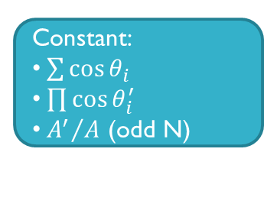
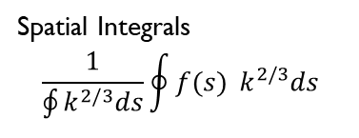
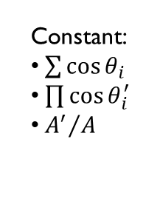
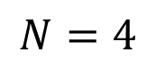
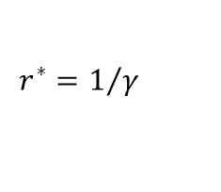
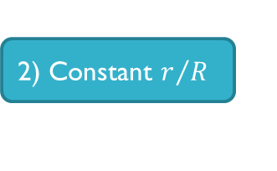
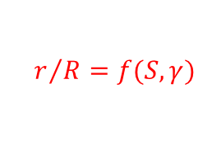
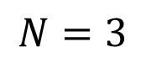
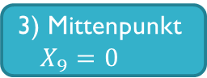
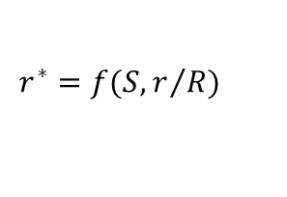
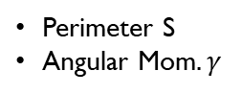
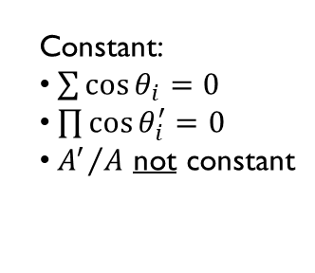
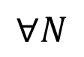
$$N=3$$
$$N=4$$
$$∀N$$
1) Loci
3) Mittenpunkt $X_{9}=0$
Generalized Mittenpunkt
Elliptic
Non-Elliptic
Quasi-Elliptic
Point
Circle
Circumbilliard
Monge’s orhtoptic
0) Integrability
constants
4) Stationary Cosine Circle
Generalized Stationary Circle
Perimeter S
Angular Mom$. γ$
$$r^{∗}=f(S,r/R)$$
$$r^{∗}=1/γ$$
2) Constant $r/R$
$$r/R=f(S,γ)$$
Constant:
$\sum{\cos{θ_{i}}}$
$\prod{\cos{θ_{i}^{′}}}$
${A^{′}}/A$
Constant:
$\sum{\cos{θ_{i}=0}}$
$\prod{\cos{θ_{i}^{′}=0}}$
${A^{′}}/A$ not constant
Constant:
$\sum{\cos{θ_{i}}}$
$\prod{\cos{θ_{i}^{′}}}$
${A^{′}}/A$ (odd N)
Spatial Integrals
$$\frac{1}{\oint{k^{2/3}ds}}\oint{f(s){ k^{2/3}ds}}$$

Slide 15
Elliptic loci
Of triangular centers

Slide 16
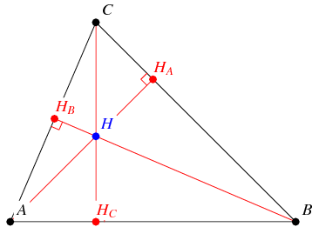
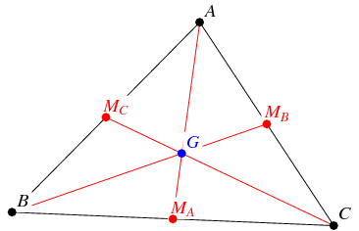
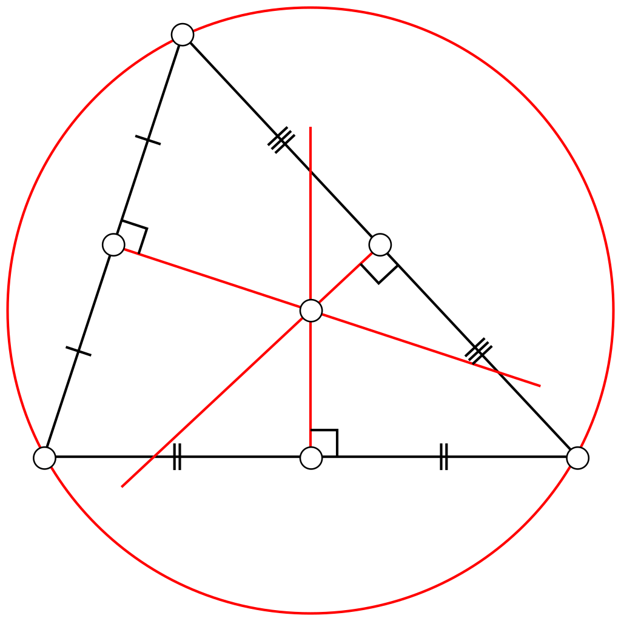
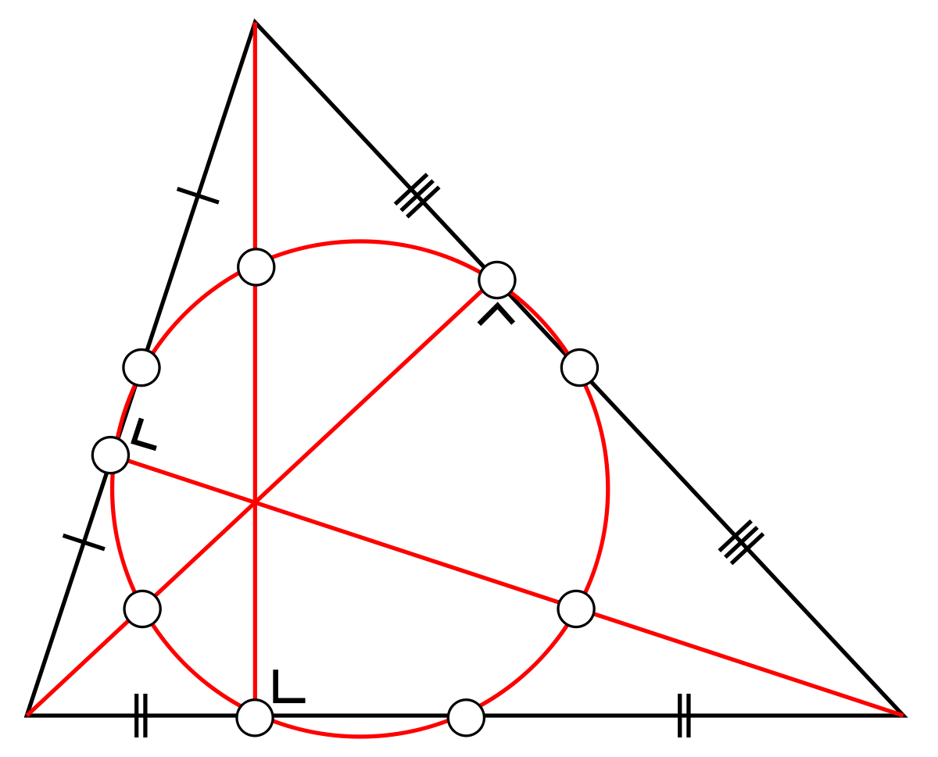
MaJOR Triangular centers
Barycenter/
Centroid
Orthocenter
Circumcenter
9-point center

Slide 17
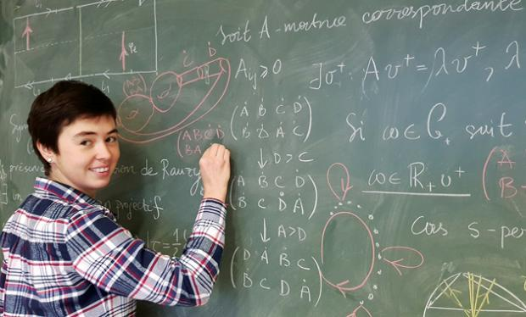
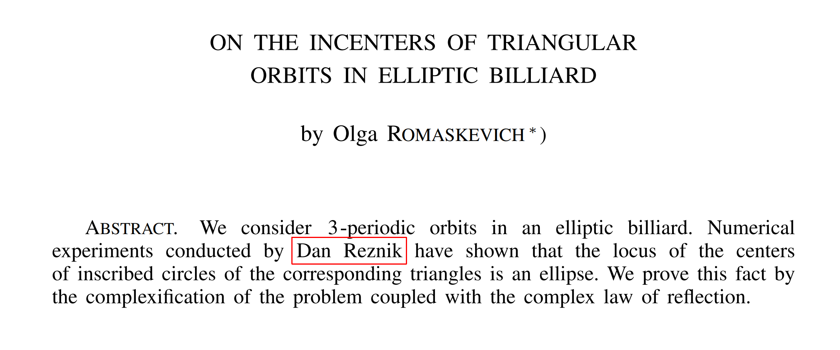
LOCUS OF INCENTER IS ELLIPTIC, 2013 PROF. Olga Romaskevich, uNIVERSITÉ de RENNES, FRANCE PDF

Slide 18


LOCUS of CIRCUMCENTER IS ELLIPTIC, 2016 (I) PROF. RONALDO GARCIA UNIVERSIDADE de GOIÁS, BRAZIL PDF

Slide 19


LOCUS of CIRCUMCENTER IS ELLIPTIC, 2019 (II) CORENTIN FIEROBE, ENS-LYON, FRANCE PDF

Slide 20



LOCUS OF BARYCENTER (for all N) is ELLIPTIC, 2016 PROFS. RICHARD Schwartz (BROWN) & SERGEI Tabachnikov (PENN STATE) PDF

Slide 21


Kimberling’s Encyclopedia of triangular centers (ETC)

Slide 22

Elliptic LOCI VIDEO
Euler
line

Slide 23
mittenpunkt
stationarity

Slide 24


Hunting for a fixed point
Christian Heinrich von Nagel
(1803–1882)

Slide 25


THE Mittenpunkt VIDEO

Slide 26

proof sketch (PROF. Olga Romaskevich)
affine

Slide 27

GENERALIZE mittenpunkt for N>3

Slide 28
A Constant of motion n=3
* Cosine sum
* Cosine product

Slide 29


Three little CIRCLES
R
$$r_{9}$$
r

Slide 30

COMPARING Radii
known
proportionality
???

Slide 31

Scatter inradius vs. circumradius

Slide 32





WONDER IDENTITY
circumcircle
R
billiard
$$θ_{2}$$
r
$$θ_{1}$$
$$\frac{r}{R}+1=\sum_{i=1}^{3}{θ_{i}}$$
incircle
$$θ_{3}$$

Slide 33

Sum of cosines = constant
θ

Slide 34

May 6th, 2019
From: <Dan> To: <Sergei>
Dear Sergei, the r/R and sum of cosines is constant over all orbits!
From: <Sergei> To: <Dan>
Dear Dan, sorry to disappoint you: this identity holds in every triangle (without relation to billiards)
From: <Dan> To: <Sergei>
Dear Sergei, we were aware of the identity. But they are both staying constant over all orbits!
From: <Sergei> To: <Dan>
Oh, I see: the claim is that for a triangular orbit the sum of cosines is an integral. This is new to me.
$$\frac{r}{R}+1=\sum_{i=1}^{3}{θ_{i}}$$

Slide 35



Corollary I: conservation of excentral COSINE product
$$θ_{i}^{′}$$
orthic
$\left|\cos{θ_{1}^{′}}\cos{θ_{2}^{′}}\cos{θ_{3}^{′}}\right|$= $\frac{r_{h}}{{4R}_{h}}$
orbit is orthic
$$H^{′}=I$$

Slide 36



Corollary II: conservation of excentral-to-orbit AREA RATIO
$$A$$
$\frac{A}{A_{h}}$= $\frac{{2R}_{h}}{r_{h}}$
$$A_{h}$$

Slide 37

Corollary III: Cosine circle is stationary VIDEO 1 VIDEO 2

Slide 38
Constants of motion
Generalizing for N>3

Slide 39


N=4: Monge’s orthoptic circle video
Gaspard Monge
(1746–1818)

Slide 40
N=4: Monge’s orthoptic circle video
Gaspard Monge
(1746–1818)

Slide 41
Clues to N>3 generalization
The locus of orthoptic points is a stationary circle.
Extend tangents from a point on locus, these define a rectangle: product of cosines is zero
Four tangency points form a parallelogram: sum of cosines is zero.
Lines from Tangential Polygon's vertices through parallelogram midpoints concur at the Ellipse's center.

Slide 42


Conversation with jair May 29, 2019.
N=3: Triangle
N=4: Parallelogram
r/R = 1+cosA+cosB+cosC
Consecutive angles supplementary:
So: cosA+cosB+cosC+cosD=0
Conserves cosine “sum”
r/R = constant
Dan: Could it work?
Jair: Try it!!!
N=5: Pentagon
cosA=-cosB, cosC=-cosD

Slide 43


N=5 works!!!

Slide 44


N=3~100 also CONSERVEs $\sum{\cos{θ_{i}}}$

Slide 45


Slide 46


Slide 47


July 3rd, 2019
From: <Sergei>, To: <Dan>
Dear Dan: Richard and I have a proof that the sum of cosines is constant. Best, Sergei
From: <Dan>, To: <Sergei>
Wizardry!

Slide 48





SKETCH OF PROOF (TABACHNIKOV et al.)
$$P_{i}$$
Joachimsthal
$$α_{i}$$
$$−∇f(P_{i})$$
$\cos{α}{=−\frac{∇f.\hat{v}}{\left|∇f\right|}=\frac{c}{\left|∇f\right|}}$ ; $\cos\left(2α\right)=2 {(\cos{α})}^{2}−1$
$\sum{cos⁡({2α}_{i})}=2c\sum{\frac{1}{{|∇f(P_{i})|}^{2}}−N}$
Complexify and analyze the poles of $\sum{\frac{1}{{|∇f(P_{i})|}^{2}}}$ over orbit as function on elliptic curve covering the conic
Show complex poles of $\sum{\frac{1}{{|∇f(P_{i})|}^{2}}}$ cancel each other
So one has a meromorphic function without poles, hence a constant.
In fact, there are $\frac{n−1}{2}$ conserved quantities.
Prove: $\sum{cos⁡({2α}_{i})} is constant$

Slide 49

July 25th 2019 TANGENT POLYGON CONSERVES *PRODUCT* OF COSINES

Slide 50



August 19th, 2019
Area Ratio between Tangential Polygon and Orbit is Conserved but only for N odd.
$$\frac{A′}{A}=k$$
Prof. Arseniy
Akopyan

Slide 51

Generalized mittenpunkt for N>3

Slide 52


STATIONARY CIRCLES FOR ALL! VIDEO
$$r^{∗}=\frac{1}{c}=\frac{1}{|∇f.\hat{v}|}$$

Slide 53
computational setup
Numerical playground

Slide 54

Experimental Playground LINK

Slide 55

Hunting 1

Slide 56

Hunting 2

Slide 57











ETC

Slide 58


Slide 59


Slide 60
My learning process
Learning
(re)Discovering
Curiosity
Experimentation

Slide 61
summary: Monge’s orthoptic circle: gateway from N=3 => all N
N=3 Invariants:
Elliptic Loci
Stationary Mittenpunk
Constant r/R
Sum Cosines
Product of Exc Cosines
Exc-to-Orbit Area Ratio
Stationary Cosine Circle
N>4 Invariants:
Excentral Medians Meetpoint
Orbit Cosine Sum
Tangential Cosine Product
Area Ratio (odd N)
Stationary Circles
Spatial Integrals
Mean Cosines
Mean Product
Gaspard Monge
(1746–1818)

Slide 62

MAIN results & Questions
Loci
Elliptic
Non-Elliptic, Quartic
Invariants
Stationary Mittenpunkt, Circles
$\sum{\cos{θ_{i}}}$
$\prod{\cos{θ_{i}′}}$
${A^{′}}/A$
Open questions:
Explain elliptic vs non-elliptic loci
Non-euclidean invariants?

Slide 63

Our Webpage: bit.ly/2JISAQ1

Slide 64

MEDIA gallery LINK

Slide 65

THANKING mathematicians
Prof. Olga
Romaskevich
Prof. Igor
Minevich
Prof. Richard
Schwartz
Corentin
Fierobe
Prof. Arseniy
Akopyan
Prof. Sergei
Tabachnikov

Slide 66

Thanking co-authors / mentors

Slide 67



Thanking Friends at impa
Prof. Paulo Ney
de Souza
Prof. Jorge P.
Zubelli

Slide 68


Thank you

Slide 69
Appendix
Feuerbach phenomena

Slide 70


Feuerbach’s theorem
extouch points
Karl Wilhelm Feuerbach
1800-1834
X(11)

Slide 71


Slide 72


Slide 73


Slide 74


Slide 75


Slide 76


Slide 77
Prof. Igor Minevich
Boston College

Slide 78

1) FEUERBACH POINT sweeps billiard 2) ANTICOMPLEMENT of FEUERBACH SWEEPS Billiard 3) EXTOUCHPOINTS SWEEP BILLIARD (in reverse!) VIDEO

Slide 79

In general loci are non-elliptic GALLERY w/ 700 LOCI

Slide 80

Non-elliptic loci: 1) Median 2) intouch 3) Feuerbach TRIANGLE VIDEO

Slide 81
Appendix
Stationary circles

Slide 82

Meet the cosine circle link
=X(6)

Slide 83


Corollary III: cosine circle is stationary! VIDEO 1 VIDEO 2

Slide 84

Can you get A circle FROM AN ellipse?

Slide 85


Poncelet-Darboux grid VIDEO
Jean-Gaston Darboux
1842-1917

Slide 86

Monge-darboux circles: A common rule VIDEO
Jean-Gaston Darboux
1842-1917

Slide 87
I didn’t know this fact, and I don’t know whether it’s new. However, here is an easy proof. --Sergei, July 13, 2019
This new phenomenon doesn't seem to follow from the Poncelet Grid [...] I don't really see how to prove this circle result right away. --Richard, July 16, 2019
This is a very nice fact. I did not know it before. Theorems of this type can be seen by analyzing a projective Poncelet picture. --Arseniy Akopyan, July 13, 2019

Slide 88

Symmedian point X(6)

Slide 89

SYMM of excentral = MITTEN of reference
K’=M

Slide 90

Simpler cosine circle construction

Slide 91


Radius of cosine circle is non-linear on sides
a
c
$$r_{cc}=\frac{a b c}{a^{2}{+b}^{2}+c^{2}}$$
$$r_{cc}$$
b

Slide 92
Appendix
conservation equations

Slide 93





Slide 94



Slide 95

Joachimsthal: M₁ M₂ is conserved

Slide 96





To prove these relationships, just get the coordinates of X_{o}

Slide 97





Slide 98




Slide 99
overflow
Slides not used

Slide 100



ELLIPse
$$P=(x,y)$$
$$−∇f(x,y)=−2\left[\begin{matrix}x/a^{2} \\ y/b^{2}\end{matrix}\right]$$
$${f\left(x,y\right)=\left(\frac{x}{a}\right)}^{2}+{\left(\frac{y}{b}\right)}^{2}=1$$

Slide 101

Gaspard
Monge
1746–1818
Jean-Victor
Poncelet
1788–1867
Karl Wilhelm
Feuerbach
1800–1834
Christian Heinrich
von Nagel
1803–1882
Ferdinand
Joachimsthal
1818–1861
Jean-Gaston
Darboux
1842–1917

Slide 102





Proof of $\frac{r}{R}$ constancy
$$A_{0}$$
$$A_{I}$$
Incenter locus is elliptic [Prof. Romaskevich]
Area ratio: $\frac{A_{I}}{A_{0}}=\frac{r}{2R}$ [Prof. Garcia]
Both are stationary => r/R constant.

Slide 103


Slide 104

Constant Inradius/circumradius
R
r

Slide 105


Slide 106



Slide 107



Circumbilliards VIDEO and APPLET

Slide 108
NINE-POINT CIRCLE X(5)
N

Slide 109


Slide 110


Slide 111


LOCUS / LOCI

Slide 112

ELASTIC TRAJECTORY Elliptic BILLIARD applet

Slide 113

Excentral objects: 1) EXCENTRAL TRIANGLE 2) EXCIRCLES 3) EXTOUCHPOINTS

Slide 114

Paul lockhart:
Mathematics is about removing obstacles to our intuition and keeping simple things simple.
Math is not about following directions, it’s about making new directions.

Slide 115

SPIROGRAPH

Slide 116



Garrincha e Bilhares: Já combinou com os Russos?

Slide 117

X(100): ANTICOMPLEMENT of FEUERBACH

Slide 118



Conservation of momentum
$$P=(x,y)$$
$$−∇f(x,y)=−2\left[\begin{matrix}x/a^{2} \\ y/b^{2}\end{matrix}\right]$$
$${f\left(x,y\right)=\left(\frac{x}{a}\right)}^{2}+{\left(\frac{y}{b}\right)}^{2}=1$$

Slide 119


TRILINEAR vs BARYCENTRIC COORDINATES

Slide 120




